Slide 1
Logo animation (intro)

Slide 2


Title slide
Ephemeral Code Environments as Code for clean, fast, powerful, easy to setup, green development environment
Lucas Jellema, CTO Conclusion
REAL ToolShed, 1st October 2024

Slide 3
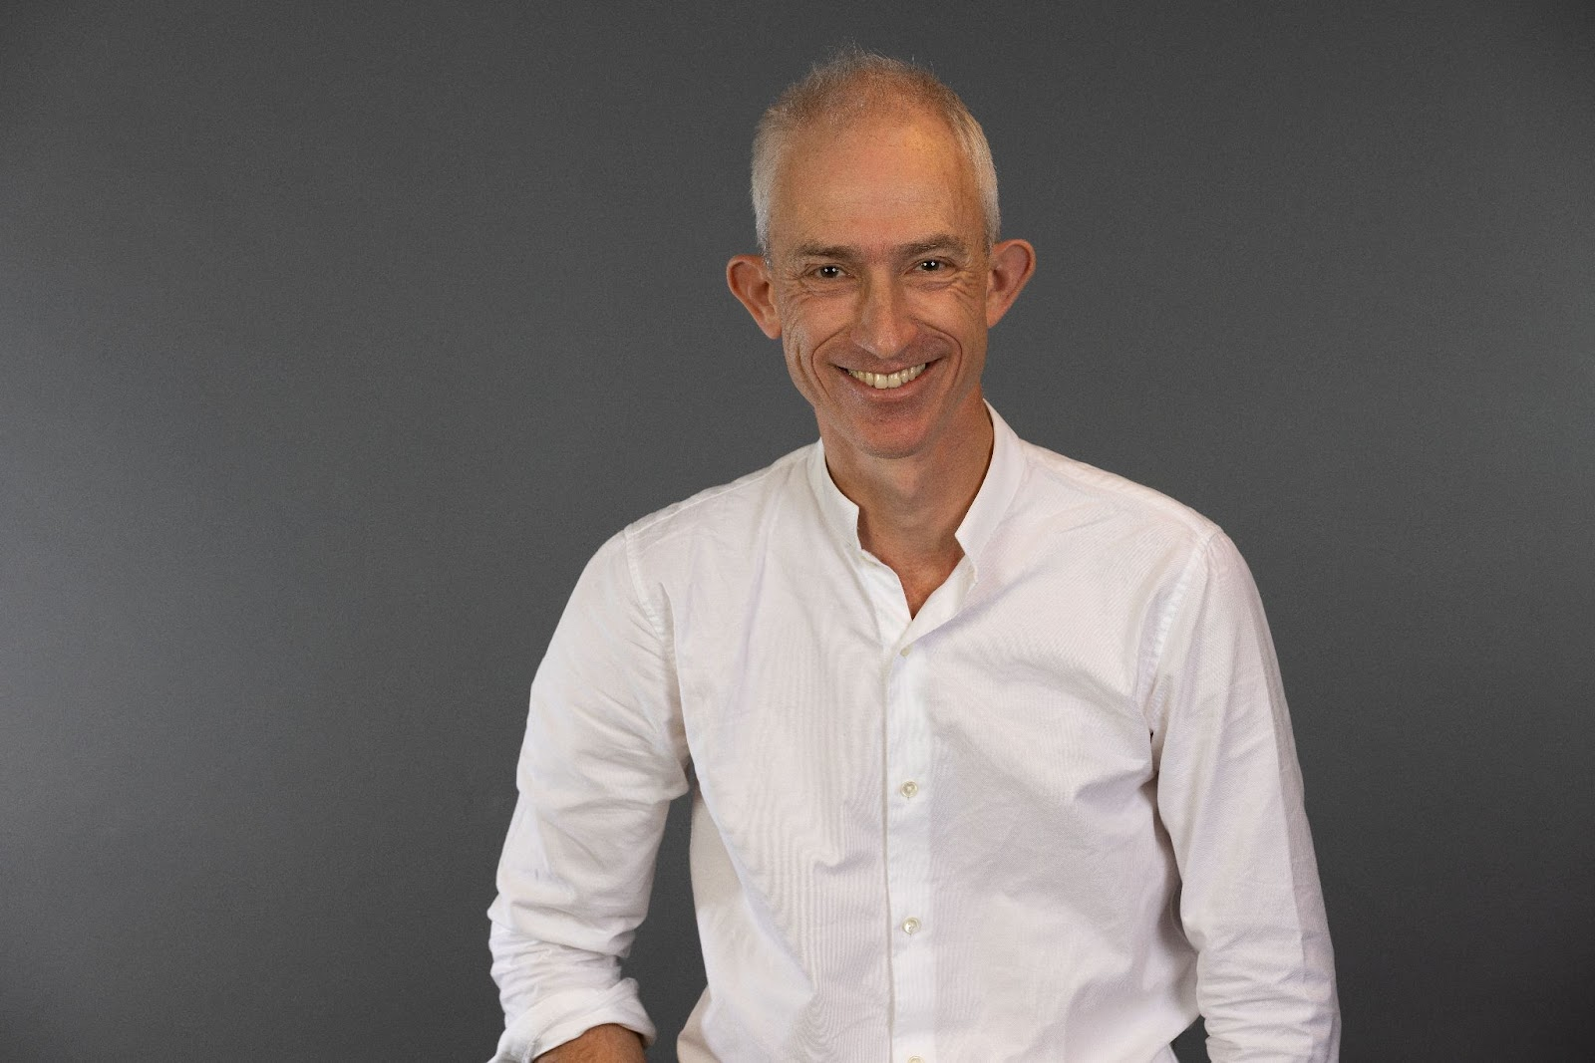
Who am I?
Lucas Jellema
Oracle ACE Director
CTO at Conclusion
ecosystem of 30 companies (2800 colleagues) in The Netherlands
Portugal, Spain, South Africa and … Germany (1500 colleagues)
IT Architect for dozens of customers
focus on custom application development, data, integration, cloud, ..
[too] much time spent on ‘trying things out’

Slide 4
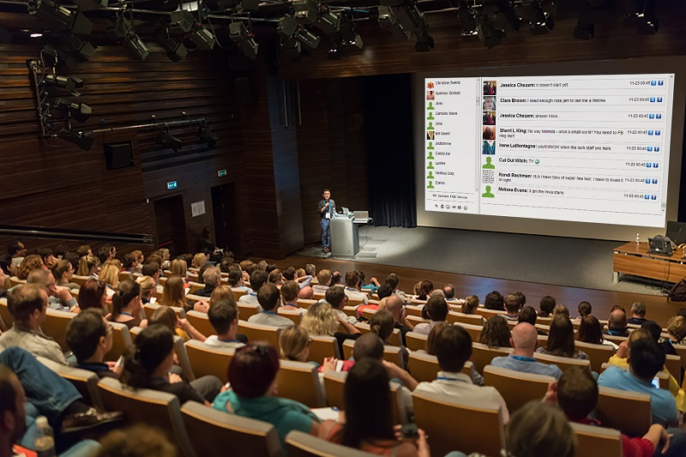



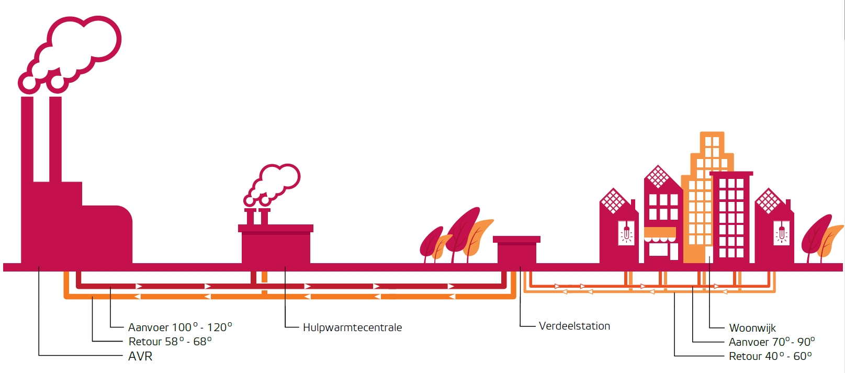

Lecture & Hands on with 150 students
picture of room with QR code on screen
Monitoring
Smart Meter
Communication Module
Ingest, Authenticate & Check
Validate, Enrich Process, Convert, Publish
Event Streaming Platform
Smart Meter
Devices
Telemetry
HEAT
IoT Platform
Notes:
Workshop Apache Kafka with 50 students
and suboptimal WiFi
workshop environment:
VS Code, Docker, multiple container images (100s of MBs of download)
configuration to make it all connect
source from a public GitHub repo
Give a QR code
everyone – had their own exact replica environment up and running in 10 minutes
except the sleeping student
And the WiFi never even knew…

Slide 5


Lecture & Hands on with 150 students
picture of room with QR code on screen
Monitoring
Communication Module
Ingest, Authenticate & Check
Validate, Enrich Process, Convert, Publish
Event Streaming Platform
Smart Meter
Smart Meter
Devices
Telemetry
HEAT
IoT Platform

Slide 6
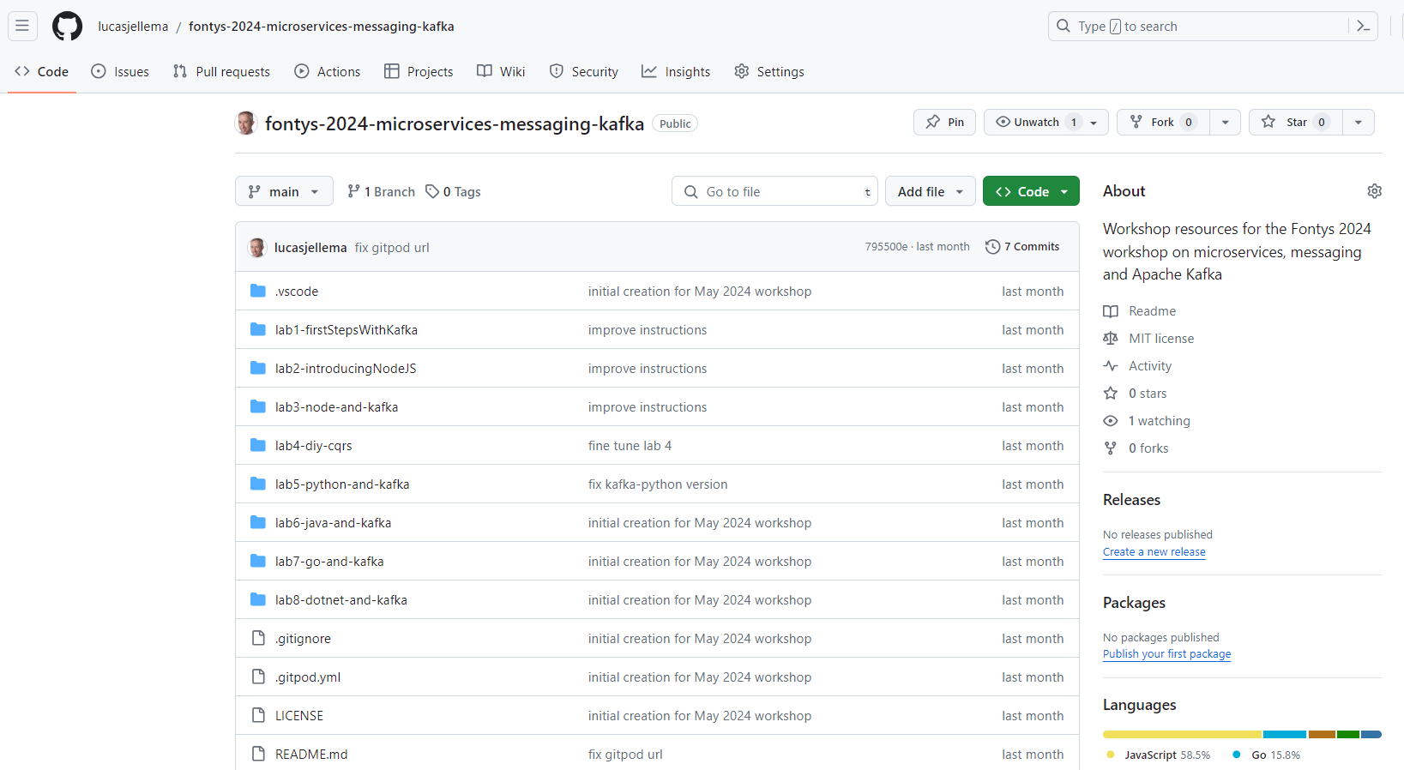
What is that URL?
https://github.com/lucasjellema/fontys-2024-microservices-messaging-kafka
https://gitpod.io/#<URL of a GitHub Repository>

Slide 7
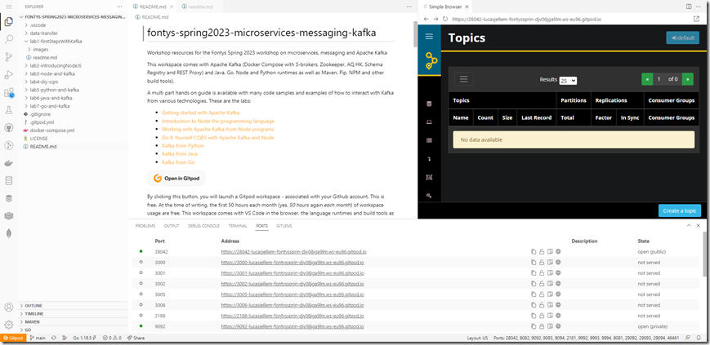


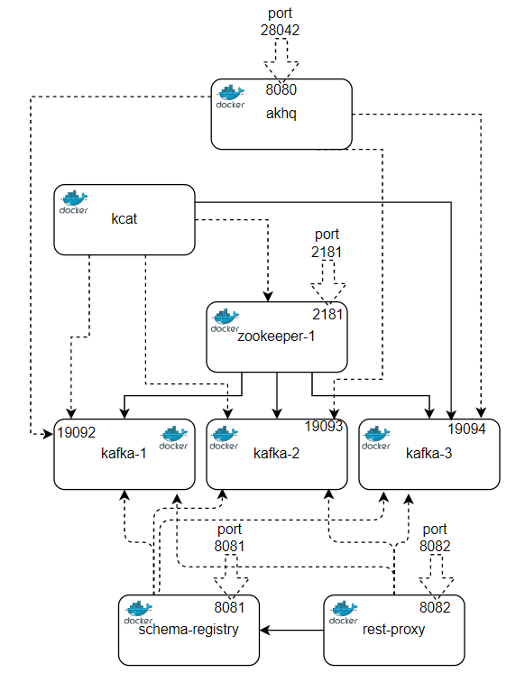





Open QR code, wait five minutes and … action!
Linux environment
Ubuntu 22.04.2 LTS (Jammy Jellyfish)
4 cores, 8GB RAM, 30 GB disk
Docker, Docker Compose
Language Runtimes: Java, Node, Go, C/C++, Python, Ruby, Rust, Clojure
Homebrew, Maven, npm, Tailscale, Nginx, Nix
VS Code in browser
3 node Kafka Cluster running – plus supporting tools (kcat, akhq, schema-registry, zookeeper, rest-proxy)

Slide 8


Slide 9
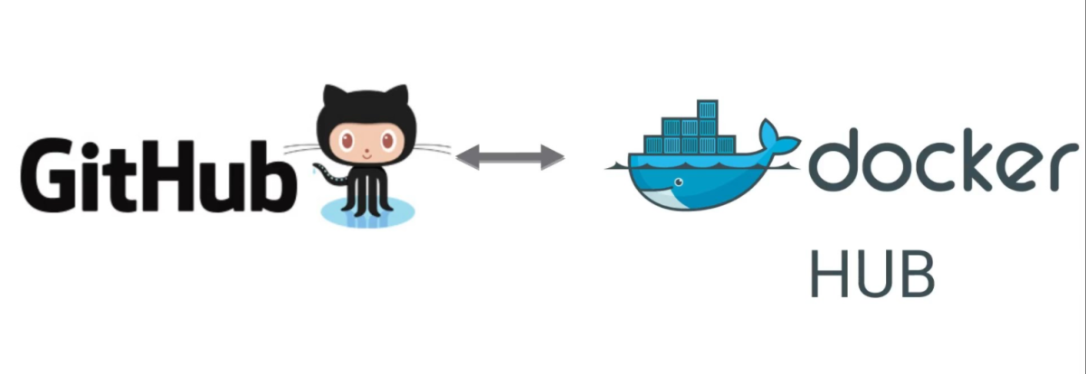


Gitpod
Linux VM
Linux VM
Linux VM
Linux VM
Linux VM
Linux VM
Linux VM
Linux VM
Linux VM
Linux VM
Linux VM
Linux VM
Linux VM
Linux VM
Linux VM
Linux VM
Linux VM
Linux VM

Slide 10


Light weight, low spec
Notes:
No need to carry around a backbreaking laptop in order to have a powerful development platform
and change specs on the go (no spec based device aging)

Slide 11


Green
Notes:
Optimal resource usage (energy, water)
Lower eWaste
Lower networking impact

Slide 12





Security
Notes:
Optimal resource usage (energy, water)
Lower eWaste
Lower networking impact

Slide 13




Template
Notes:
Hard to put together project environment vs ready to run (great for on-boarding, workshop, exploration)
Instead of manually installing and configuring, following step by step instructions with many opportunities to screw up – just execute “code” to provision the development environment
hands-off, background process
proven template, always right
great for collaboration

Slide 14




Maintenance
Notes:
Hard to put together project environment vs ready to run (great for on-boarding, workshop, exploration)
Instead of manually installing and configuring, following step by step instructions with many opportunities to screw up – just execute “code” to provision the development environment
hands-off, background process
proven template, always right
great for collaboration

Slide 15
Biggest Imachinable
€/h
€
Notes:
Use the most powerful desktop imachinable
without having to buy it
pay only for actual usage

Slide 16



BYOD & BYOC
€/h
€
Notes:
Use the most powerful desktop imachinable
without having to buy it
pay only for actual usage

Slide 17



project/product specific databases, middleware, AI models, <anything>
Linux, bash, git, VS Code for the Web, Docker, Language Runtimes, npm | maven | pip, tools for lint, test, build, package
CPU / GPU, RAM, Storage
internet
Development Environment
Device
Development Environment
Device
Notes:
Ephemeral Development Environment Terminal Mainframe 2.0, Citrix/VDI 2.0
Thin client
thin network connection
can be Chromebook/Netbook or even Tablet or Smartphone
work as if everything is local (SSH, localhost, desktop IDE)
Cloud based platform
scalable compute resources (memory, CPU/GPU)
quick start up (& shutdown) and refresh
thick pipe to internet (Maven, PyPI, npm, … for quick installs)

Slide 18









Platform Options
self managed
vendor managed
SaaS
VM
VM
VM

Slide 19
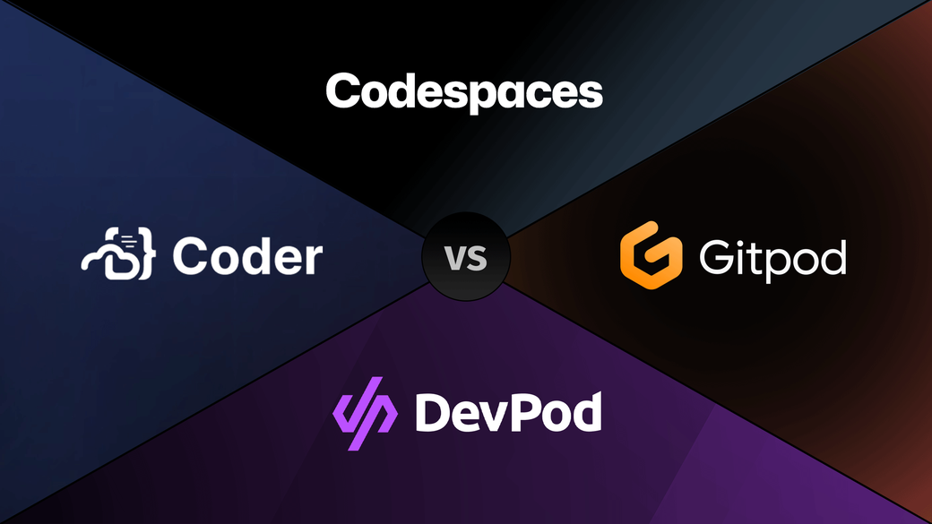
Prominent Offerings
Gitpod **
GitHub Codespaces **
DevPod *
Coder *
Replit **
Microsoft Dev Box, Google Cloud Workstation
* - open source, ** - free tier

Slide 20
Demo

Slide 21
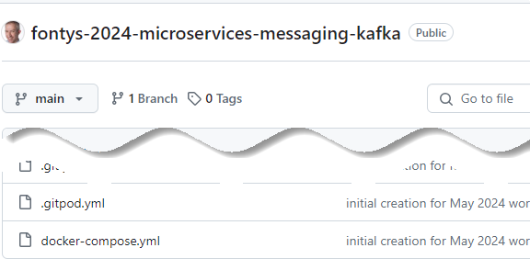
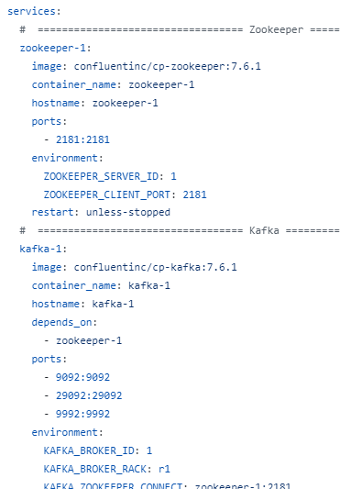
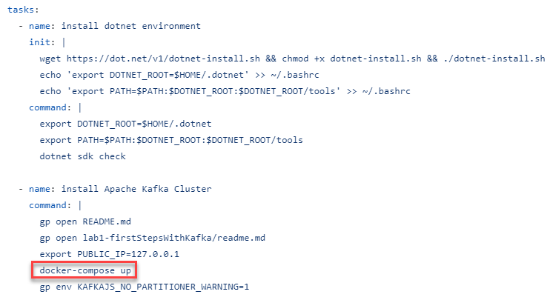
Gitpod.yml

Slide 22
How can you get going?
Just open a Gitpod#GitHub Repo URL – open an ephemeral workspace with the environment set up for and with all sources in the Repo
including all downloaded packages
if the repo contains a .gitpod.yml file, then additional finetuning (such as download and installation of software or pull and run container images)
Start a generic or tailored Development Environment
on SaaS – Codespaces, Gitpod, Replit
using a local DevPod provider or VS Code DevContainers (local Docker container)
on IaaS with Coder or DevPod

Slide 24



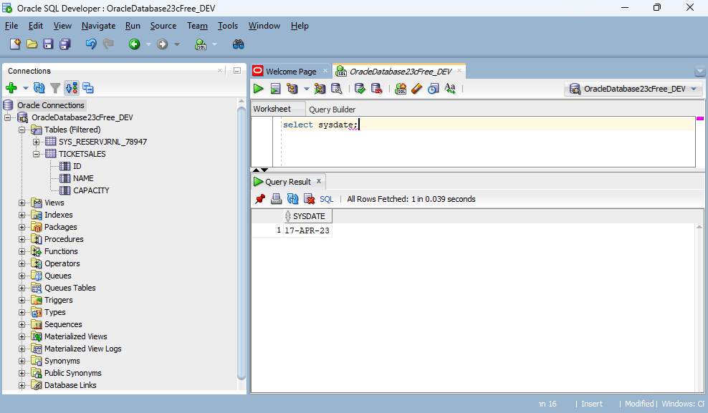

Explore latest Oracle Database release plus tools
Gitpod workspace
Tool
Tool
Tool
workspace
Notes:
https://technology.amis.nl/database/gitpod-workspace-for-oracle-database-free-23ai-click-and-run-free-and-in-7-minutes/
https://gitpod.io/#https://github.com/lucasjellema/gitpod-oracle-database-23ai-free-
initial creation : 5-7 minutes; subsequent startup: 10-15 seconds

Slide 25
Sizes and Prices
Product | Free Tier | Standard Shape | Normal Rate | Out of the box shapes
Gitpod | 50 hours / month | 4 cores | 8GB | 30 GB | €0.36 / hour | 4, 8, 14, 30 cores 8, 16, 30, 54 GB RAM
GitHub Codespaces | 30 hours / month | 4 cores | 8GB | 15 GB | $0.36 / hour + $0.07 / month per GB Storage ( $2.88 / hour for 32 Cores & 64 GB RAM) | 2, 4, 8, 16, 32 cores – with associated RAM unlimited storage
Replit – development & deployments | 10 hours / month | 1 core | 2GB | 2GB + 50MB database + free static deployment | $15/month for 4 cores | 8GB | 50GB + AI Chat(unlimited hours) | up to 16 cores & 32 GB
DevPod & Coder (on IaaS) | <standard free tier on public cloud for compute and storage> | <configure using standard VM shapes or container sizing> | $ 2.00 - $ 5.00 / month | any VM (or container) size offered by public cloud provider
Notes:
Gitpod – 50 hrs/month ( then €0.36 / hour) – for 4 cores | 8GB RAM| 30 GB
GitHub Codespaces – 15 GB storage & 120 Core hours / month; ( then $0.36 / hour - $2.88 / hour for 32 Cores & 64 GB RAM + $0.07 / Hour per GB Storage)
AWS Cloud9 – 1 year free tier for EC2 & EBS; then only regular EC2 and EBS costs, from $2.50 / month
Coder and DevPod – cloud IaaS costs (e.g. on AWS: $0.08 / hour + $0.08 / GB /month)

Slide 26





Great first use cases
Notes:
Explore technology – new open source project, new library or framework
Study environment – to prepare for certification exam
Collaborate with friends on an outside-of-work project
Run a workshop with a small or large group of participants

Slide 27








Ephemeral Development Environments
€
€/h
lucas.jellema@conclusion.nl | technology.amis.nl | @lucasjellema | lucas-jellema

Slide 28
Common Features
Adjust Workspace Sizing
Configuration file to specify the workspace makeup
.devcontainer (.gitpod.yaml)
custom container image
VS Code in a browser
git integration
SSH for local-remote connection
Addins for popular IDEs
local desktop connect transparently to remove environment
Share an environment (collaborate in a single workspace)
Compute Providers (public cloud, Kubernetes, Docker, VM, ..)

Slide 29
Logo
www.conclusion.nl

